Slide 1

Four Step Process
Reading: 0.2
exercises: All chapter 0
Assigned: hw 1
Producer: dr. mario
img credit: alex riegert-waters

Slide 2
Course Website / Syllabus
Access Course Website Through Canvas
Cover Syllabus
Office Hours
Grading and Curving
Attendance: UNC Check-In App
Homework
Quizzes
Exams
PDFs and Gradescope
Grade Disputes
Honor Code
Usage of Course Website and Canvas

Slide 3
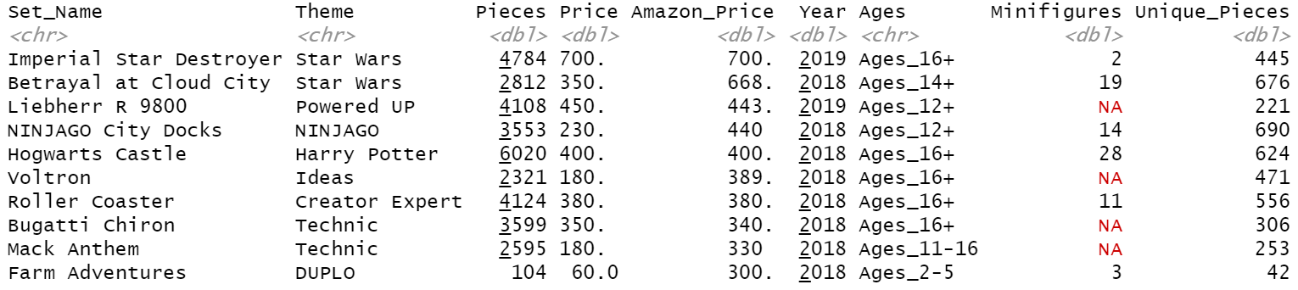
Preview of Dataset
LEGO Dataset (n=1304)
Any interesting questions about LEGO we may want to answer?

Slide 4
Models Help Us…
Answer Questions
Make Predictions or Classifications
Evaluate Treatments or Test Theories
Understand Relationships

Slide 5
Architecture of a Model
Explanatory Variable(s)
Error or Deviation from the Model
Response Variable
Generates an Expectation about Y given X

Slide 6
Statistical Modeling
Statistical Modeling is the Process of …
Defining the Function f(X) and then Fitting that Function f(X)
to a sample dataset by Minimizing the Error the best we possibly can
Methodology we Use Depends on the Types of Variables

Slide 7
Variable Types
Categorical
Quantitative
Nominal
Ordinal
Continuous
Discrete
LEGO Theme
LEGO Ages

Slide 8
Preview of Dataset
Can we find all the variable types in this dataset?

Slide 9
Example of Variable Types Using LEGO
Categorical
Quantitative
Nominal
Ordinal
Continuous
Discrete
LEGO Theme
LEGO Ages
LEGO Price
LEGO Pieces

Slide 10
Families of Models
Complicated by multiple predictor variables and/or response variables
Response Variable
Predictor Variable
Categorical
Categorical
Quantitative
Quantitative

Slide 11
Technology We Will Use
R = a free, widely used, open source, language and environment for statistical computing and graphics
RStudio = an interface for R (Integrated Development Environment)
RMarkdown = a tool in R for creating documents that combine R code with text
Download R and RStudio to Your Computer

Slide 12
Supplement for Lecture 1
Download Zip Folder on Course Website for Supplement
Unzip Folder on Your Computer
Open the Template.rmd File from the Unzipped Folder
RMD Files Should Automatically Open in RStudio

Slide 13
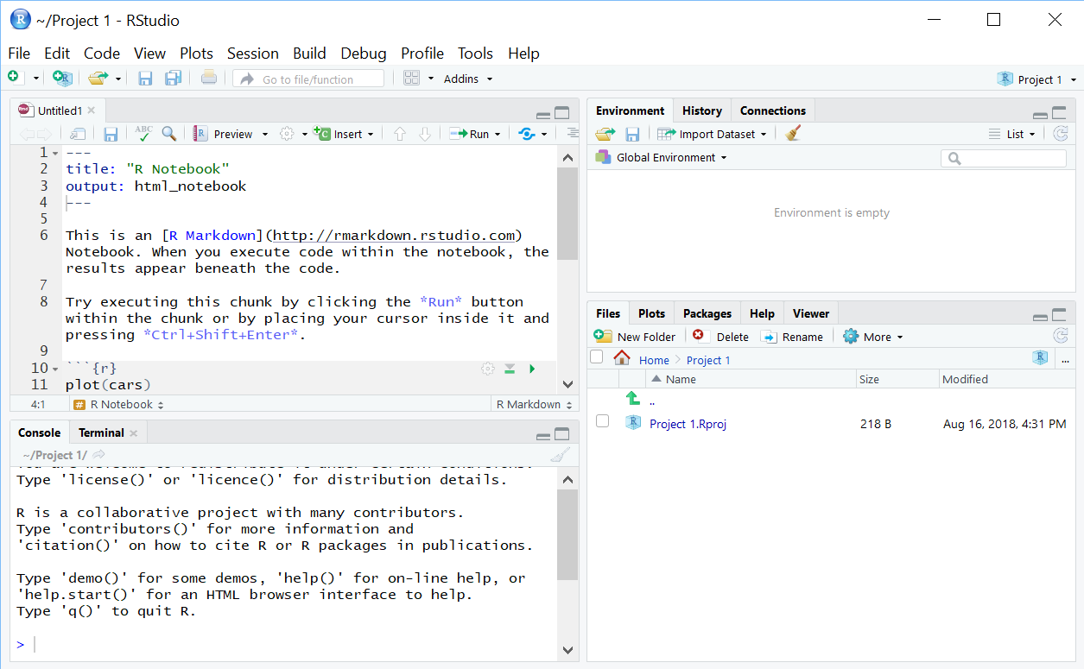
Quick Look at R Studio
Environment: lists active variables, functions, …
Editor: write/view code, data
Access files
View plots
Control packages
View help
Console: Enter commands, view output, error messages

Slide 14
Learning Objectives for R
Install Packages
Load Packages
Read CSV Files
Create Objects
Columns and Rows
Subset Data
Basic Statistical Functions

Slide 15
Thank You
Make Reasonable Decisions

